Slide 1
CSS Research paper
Byte – Rotation Encryption Algorithm (BREA)
Members:
1) Crystal Cuthinho – 7053
2) Nevil D’souza – 7059
3) Melwyn Saldanha - 7097

Slide 2
introduction
Reasons to develop BREA
To enhance data security
To increase speed & efficiency of algorithm
To use multithreading for parallel processing on single processor

Slide 3
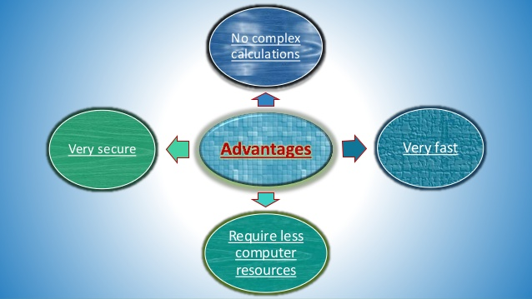
introduction

Slide 4
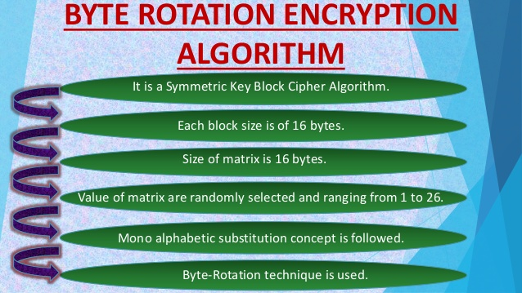
Concepts used

Slide 5
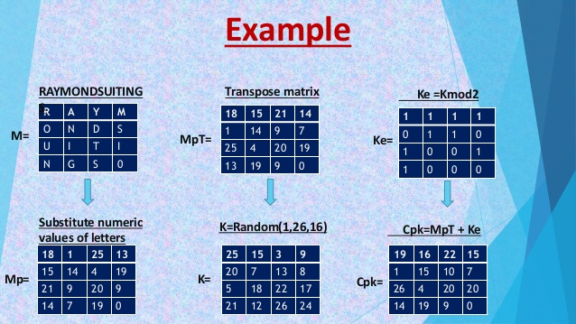
Steps of brea:

Slide 6
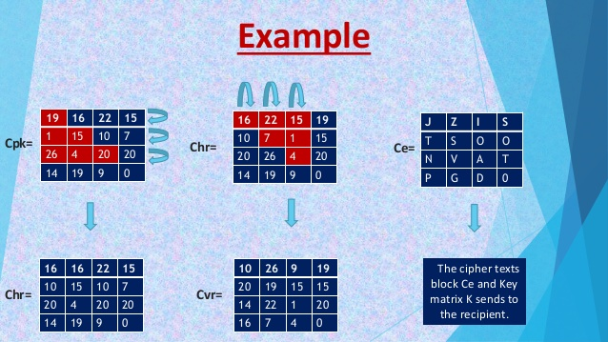
Steps of brea:

Slide 7
Steps of brea:
Summary of steps:
Assignment of values:
Letters A,B,..,Z as 1,2,..,26.
Digits 1,2,..,9 as 27,28,..,35.
Digit 0 as 0 only.
PT is divided into blocks of 16 bytes represented by Matrix Mp.
Key is array K of size 16 which has values generated from random(1,26) with repetition.
Perform transpose of Mp as Mp^T
Formulate Encrypted Key matrix Ke using for i in Ke: i=i%2
Resultant Matrix Cpk = Mp^T + Ke

Slide 8
Steps of brea:
Summary of steps:
Since Cpk is a 4x4 matrix,
Rotate 1st row by 1 element, 2nd row by 2 elements, 3rd row by 3 elements, 4th row by 0 elements. This gives matrix Chr.
Rotate 1st column by 1 element, 2nd column by 2 elements, 3rd column by 3 elements, 4th column by 0 elements. This gives matrix Cvr.
Matrix Cvr is the final encrypted block
Reverse BREA at receiver’s end for decryption

Slide 9
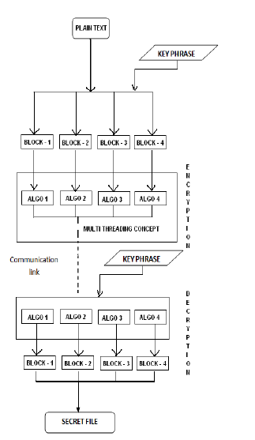

Slide 10
Concept of multithreading

Slide 11
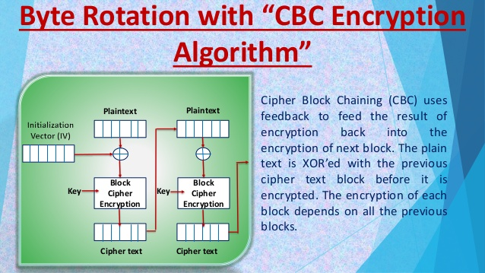
Revised & enhanced version:

Slide 12
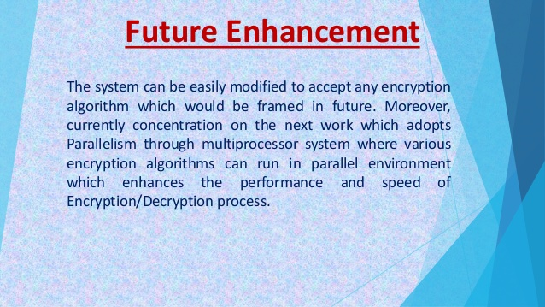
Future enhancements

Slide 13
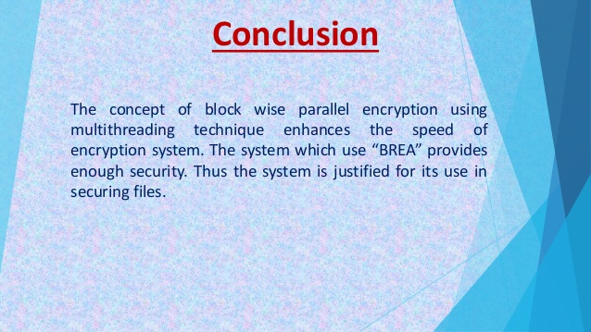
conclusion

Slide 14


